Slide 1
Python for data science

Slide 2


Slide 3
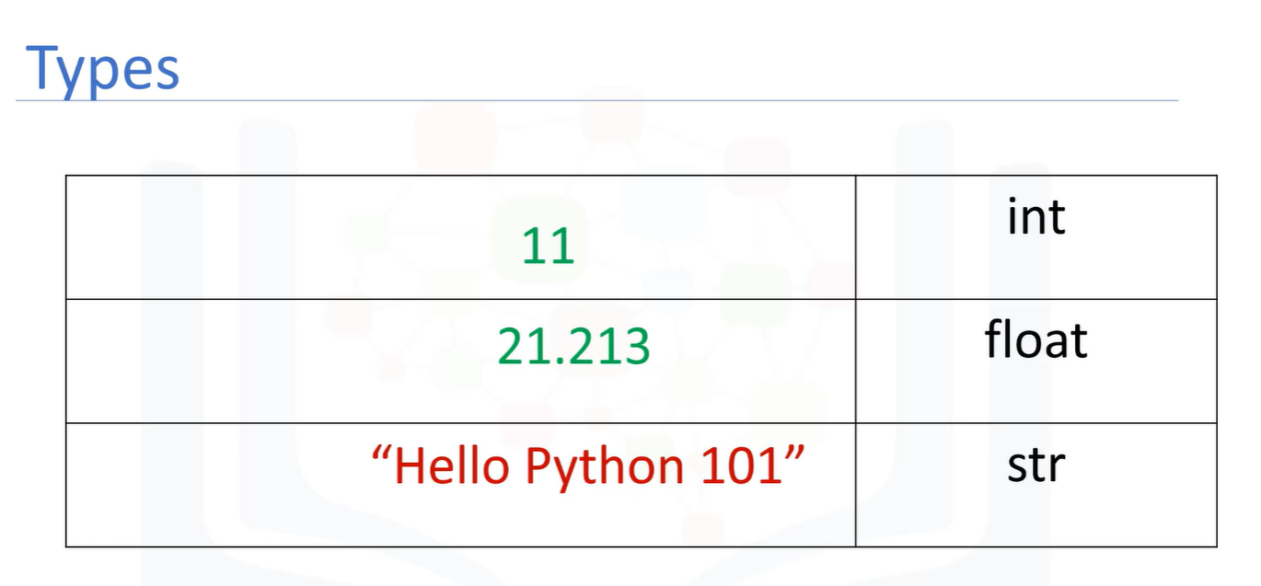





Slide 4
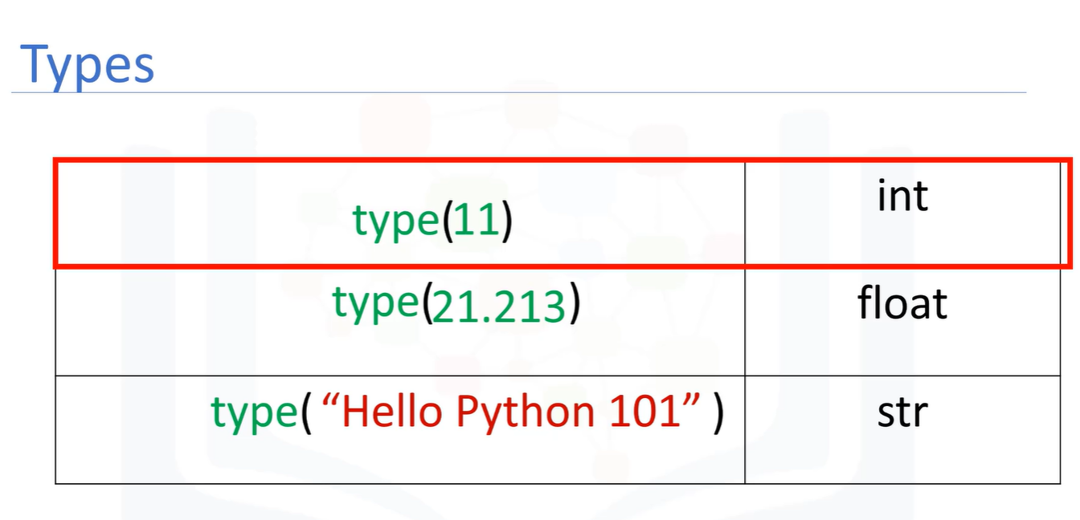
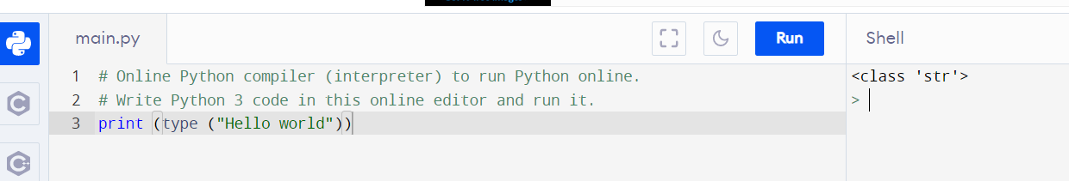








Slide 5
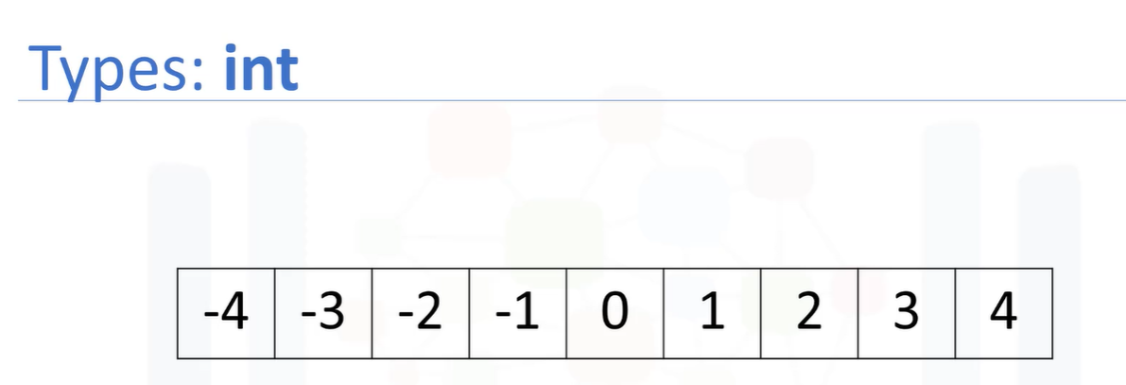
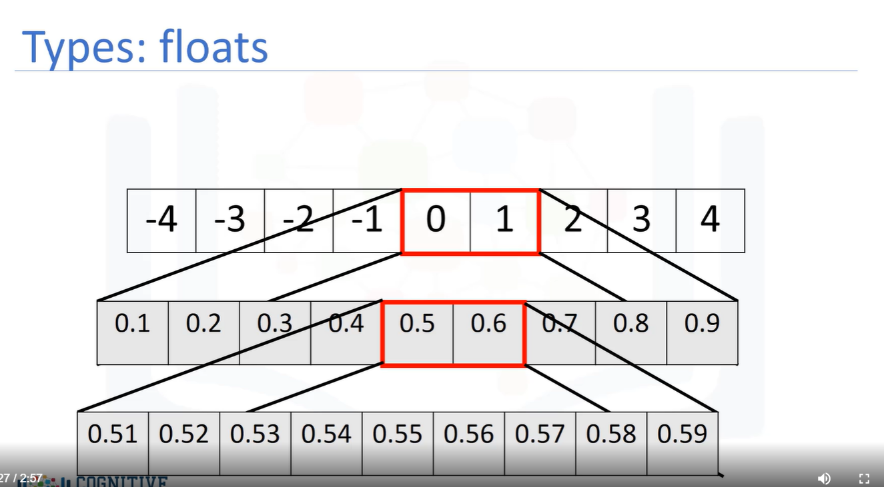

Slide 6
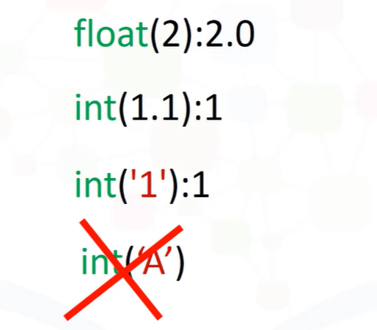
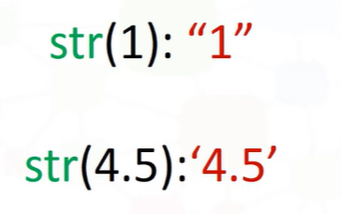






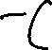







Type cast

Slide 7
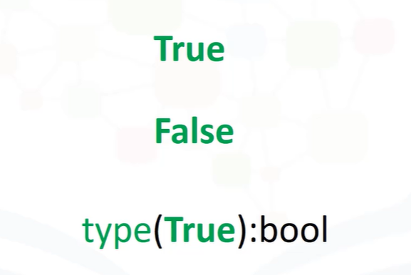
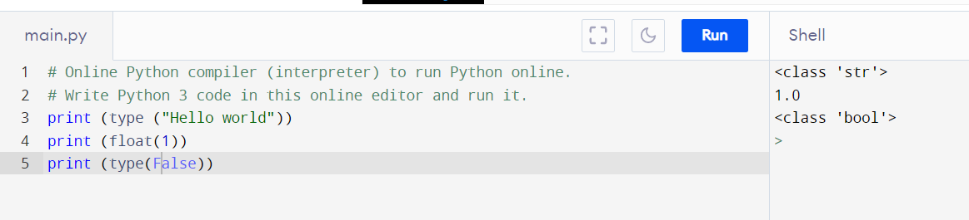











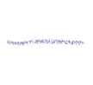

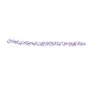










Boolean data type

Slide 8
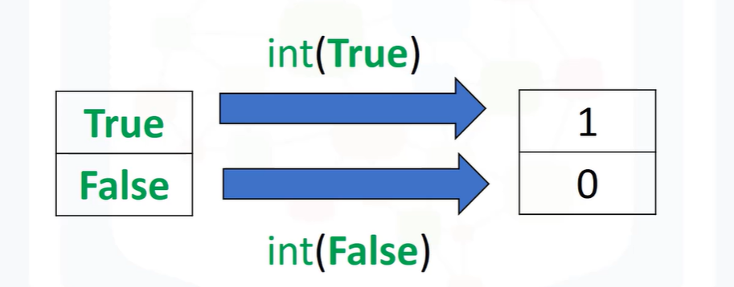
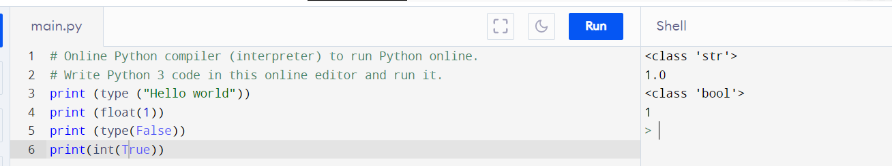
































Type cast Boolean DT

Slide 9
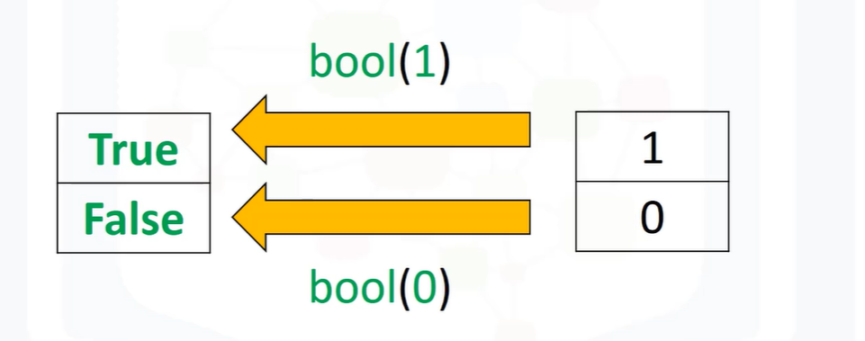
























Type casT Bool

Slide 10
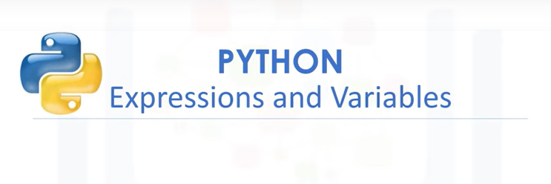

Slide 11
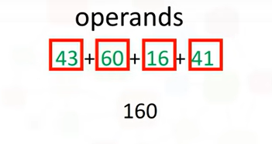
Expressions describe a type of operation that computers perform.
Expressions are operations that Python performs. For example, basic arithmetic operations like adding multiple numbers. The result, in this case, is 160
We call the numbers operands and the maths symbols, in this case addition, are called operators.

Slide 12
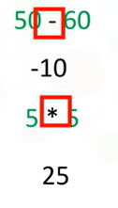
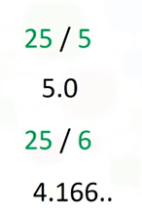
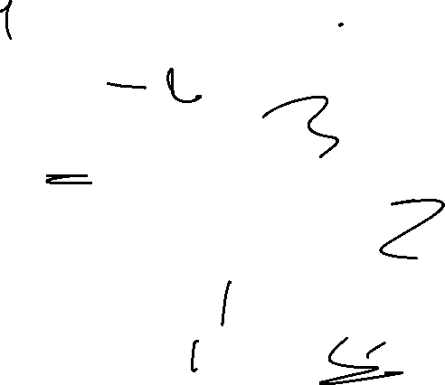



We can perform operations such as subtraction using the subtraction sign. In this case, the result is a negative number.
We can perform multiplication operations using the asterisk. The result is 25.
In this case the operands are given by – and *.
We can also perform division with the forward slash.
25 divided by 5 is 5. 25 divided by 6 is approximately 4.167.

Slide 13
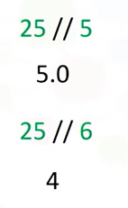
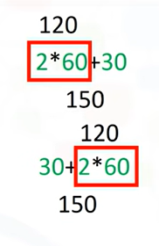































We can use the double slash for integer division, where the result is rounded.
Python follows mathematical conventions when performing mathematical expressions.
The following operations are in a different order.
In both cases, Python performs multiplication, then addition to obtain the final result.

Slide 14
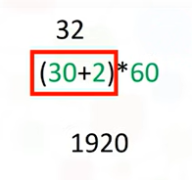
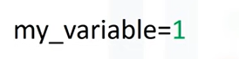
The expressions in the parentheses are performed first. We then multiply the result by 60, the result is 1920.
Now let’s look at variables.
We can use variables to store values, in this case, we assign a value of 1 to the variable
my_variable using the assignment operator i.e., the equals sign.

Slide 15
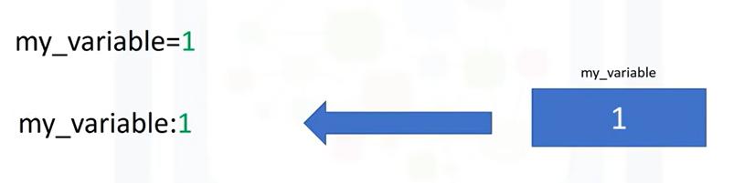

Slide 16
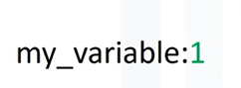
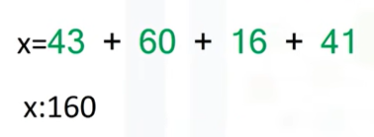
We can then use the value somewhere else in the code by typing the exact name of the variable.
We will use a colon do denote the value of the variable.
We can store the results of expressions, for example, we add several values and assign the result to x.
x now stores the result.

Slide 17
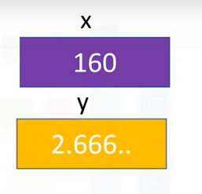
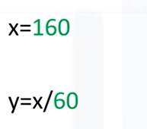
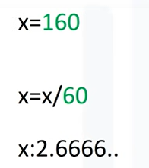
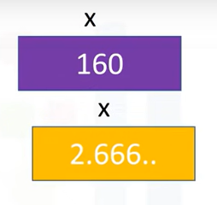
We can also perform operations on x and save the result to a new variable y. y now has a value of 2.666
We can also perform operations on x and assign the value x.
The variable x now has a value 2.666. As before, the old value of x is not important.

Slide 18
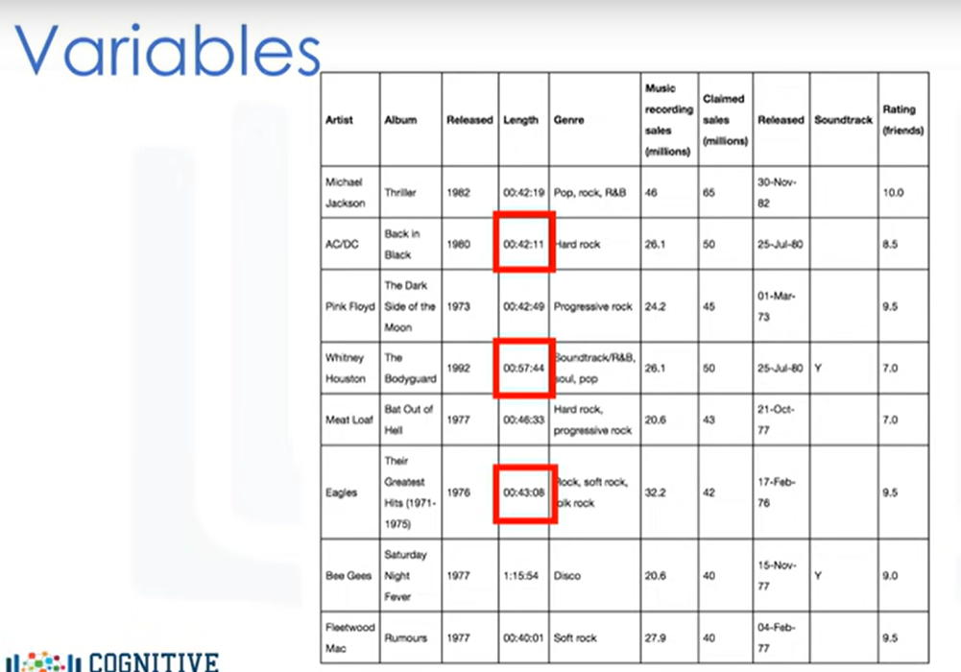
Let’s say we would like to convert the number of minutes in the highlighted examples to number of hours in the following music dataset.

Slide 19
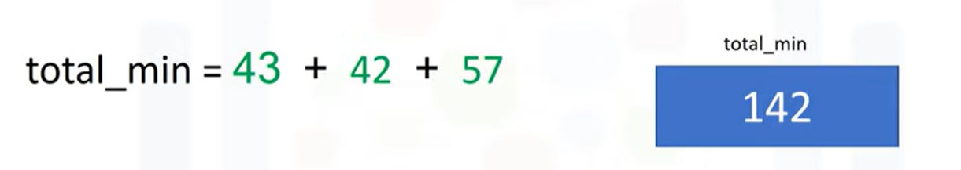
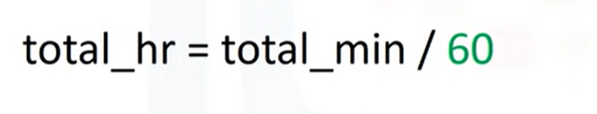
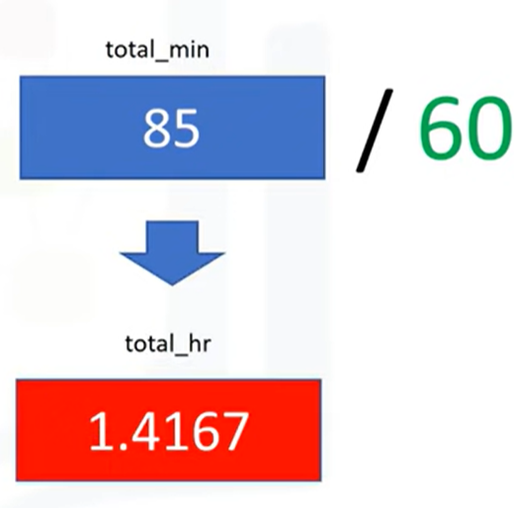
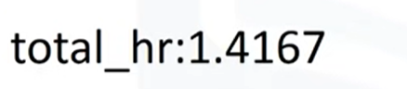
We can obtain the total number of hours by
dividing total_min by 60. The result is approximately 2.367 hours.

Slide 20


Slide 21
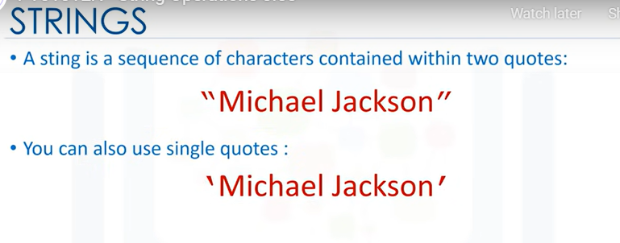
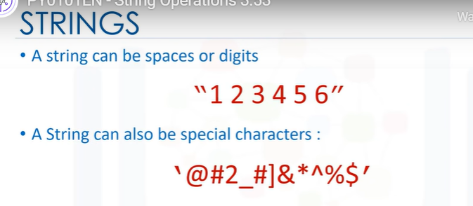

Slide 22
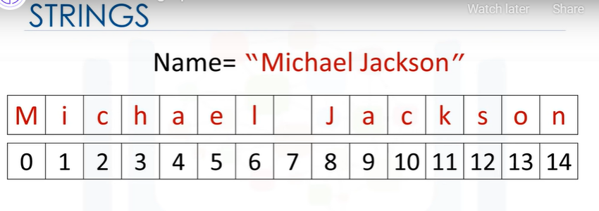
We can bind or assign a string to another
variable. It is helpful to think of a string as an ordered sequence.
Each element in the sequence can be accessed using an index represented by the array of numbers.

Slide 23
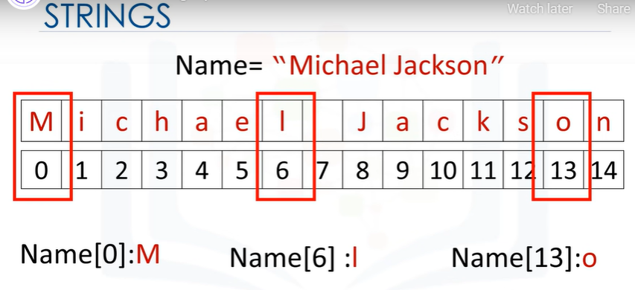
































Slide 24
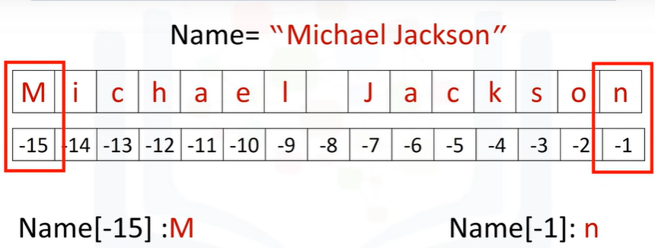
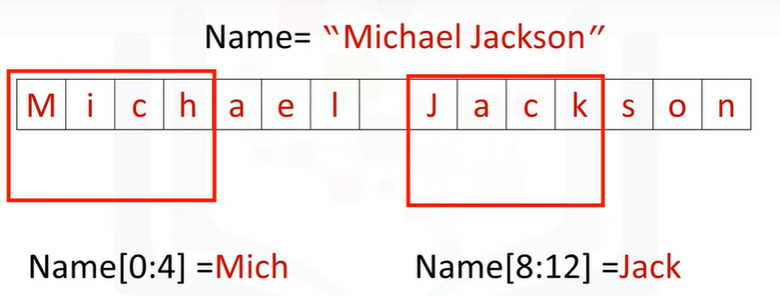




























We can also use negative indexing with strings.
The last element is given by the index -1. The first element can be obtained by index -15, and so on.
We can bind a string to another variable.
It is helpful to think of string as a list or tuple.
We can treat the string as a sequence and perform sequence operations.

Slide 25
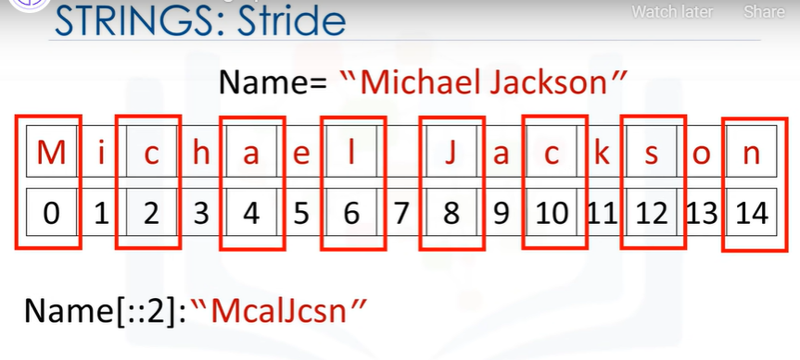



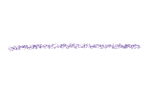



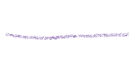















We can also input a stride value as follows.
The 2 indicates we select every second variable.

Slide 26
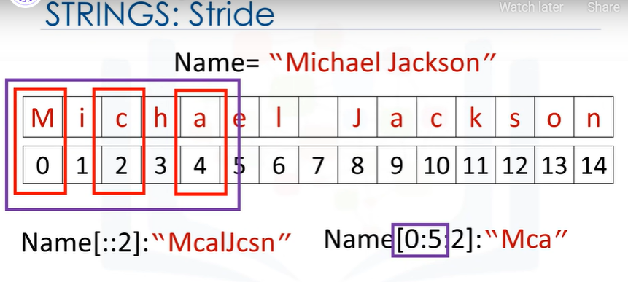






















We can also incorporate slicing.
In this case. we return every second value up to index four.

Slide 27
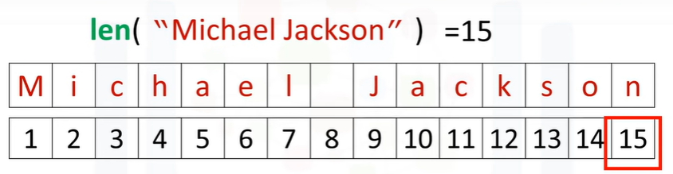












We can use the “len” command to obtain the length of the string. As there are 15 elements, the result is 15.

Slide 28
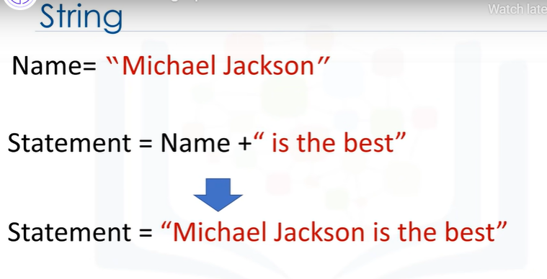

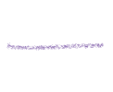


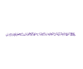


















We can concatenate or combine strings. We use the addition symbols.
The result is a new string that is a combination of both.

Slide 29






















We can replicate values of a string. We simply multiply the string by the number of times we would like to replicate it, in this case, three.

Slide 30










































This means you cannot change the value of the string, but you can create a new string.
For example, you can create a new string by setting it to the original variable and concatenated with a new string.

Slide 31






























Slide 32

























































If you want to place a backslash in your string, use a double backslash

Slide 33

We can also place an r in front of the string.

Slide 34

Now let’s take a look at String Methods. Strings are sequences and, as such, have apply methods that work on lists and tuples. Strings also have a second set of methods
When we apply a method to the string "A”,
we get a new string “B" that is different from "A".

Slide 35
































Slide 36










































The method replaces a segment of the string, i.e., a substring with a new string. The result is a new string with the segment changed.

Slide 37




















The method find, finds sub-strings. The argument is the sub-string you would like to find.
The output is the first index of the sequence.
We can find the sub-string Jack.
If the sub-string is not in the string, the output is negative one. Check the labs for more examples.

Slide 38
exercise
1. Print "Hello" and "World" on two separate lines using single print statement
2. Find the type of the following
A)”Hello World”
B)”1.1”
3. Cast the following into bool
A) “1”
4. Find the first four elements of the following string:
A) Letters="ABCDEFGHIJK
5. Use a stride value of 2 on the following string
A)Good="GsoAo+d“

Slide 39
6. Convert the following string to uppercase
A) "uppercase“
7. What version of Python are we using
import sys
print(sys.version)
8. Writing comments in Python
9.System settings about float type
sys.float_info
10. Converting numbers to strings
A)1
B)1.2
11. What is the data type of the result of 6/2
12. What is the data type of the result of 6 // 2

Slide 40
13.let a=“1” b=“2” execute c=a+b and print c
14. From d=ABCDEFGH print only the substring DEF
15.What is the output of print(“\\”), print(“\\\”)
16. Consider the var g, and find the first index of the sub-string “snow”
g = "Mary had a little lamb Little lamb, little lamb Mary had a little lamb Its fleece was white as snow And everywhere that Mary went Mary went, Mary went Everywhere that Mary went The lamb was sure to go“
17. In the g string replace every occurrence of Mary by Bob
18 Let a=[23,45,34,56,67,78,78,89,56,45,12]
Print the elements from the 5th location to the end using sequence

Slide 41


Handle File in Python
In this section we will use Python’s built-in open function to create a file object and obtain the data from a txt file.
We will use Python’s open function to get a file object.
We can apply a method to that object to read data from the file.

Slide 42






















We can open the file Example1 ". txt" as follows
We use the open function.
The first argument is the file path.
This is made up of the file name and the file directory.
The second parameter is the mode; common values used include 'r' for reading, 'w' for writing and 'a' for appending.
We will use ‘r’ for reading.

Slide 43




















Finally, we have the file object.
We can now use the file object to obtain information about the file.

Slide 44

































We can use the data attribute name to get the name of the file.
The result is a string that contains the name of the file.

Slide 45














We can see what mode the object is in using the data attribute mode.
An ‘r’ is shown representing read.

Slide 46



You should always close the file object using the method close.
This may get tedious sometimes, so let’s use the “with statement.”

Slide 47















































Using a 'with' statement to open the file is better practice because it automatically closes the file.
The code will run everything in the indent block, then closes the file.
This code reads the file Example1.txt; we can use the file object File 1.
The code will perform all operations in the indent block then close the file at the end of the indent.
The method read stores the values of the file in the variable file_stuff as a string.
You can print the file content.
You can check if the file content is closed, but you cannot read from it outside the indent.
But you can print the file content outside the indent as well.

Slide 49


We will see the following.
When we examine the raw string, we will see the slash n; this is so Python knows to start a new line.
We can output every line as an element in a list using the method readlines.
The first line corresponds to the first element in the list.
The second line corresponds to the second element in the list, and so on.

Slide 50

We can use the method readline to read the first line of the file.
If we run this command, it will store the first line in the variable file_stuff, then print the first line.

Slide 51

We can use the method read line twice: The first time it’s called, it will save the first line in the variable file_stuff and then print the first line.
The second time it’s called it will save the second line in the variable file_stuff and then print the second line.

Slide 52

We can use a loop to print out each line individually as follows.

Slide 53


Let's represent every character in a string as a grid.
We can specify the number of characters we would like to read from a string as an argument to the method readlines.
When we use a 4 as an argument in the method readlines, we print out the first four characters in the file.

Slide 54

Each time we call the method, we will progress through the text.
If we call the method with the argument 16, the first 16 characters are printed out and then the new line.
If we call the method a second time, the next five characters are printed out.
Finally, if we call the method the last time with the argument 9, the last 9 characters are printed out.

Slide 56
1. DO ALL THE ABOVE COMMANDS from slide 41-52
2. using iteration instead of readlines() function print the lines in the file
3. Read all lines and save as a list and Print the first line

Slide 57


Slide 58



We can also write to files using the open function.
We will use Python’s open function to get a file object, to create a text file, we can apply method write to write data to that file.
As a result, text will be written to the file.

Slide 59




We can create the file Example2".txt" as follows:
We use the open function.
The first argument is the file path.
This is made up of the file name; if you have that file in your directory, it will be over written, and the file directory.
We set the mode parameter to 'w' for writing.
Finally, we have the file object.

Slide 60

As before we use the "with" statement.
The code will run everything in the indent block, then close the file.
We create the file object File 1.
We use the open function.
This creates a file Example2.txt in your directory.
We use the method write to write data into the file.
The argument is the text we would like input into the file.

Slide 61

If we use the write method successively, each time it’s called, it will write to the file.
The first time it is called we will write: this is line A with a slash n to represent a new line.
The second time we call the method it will write: this is line b.
Then it will close the file.

Slide 62




We can write each element in a list to a file.
As before we use a "with" command and the open function to create a file.
The list 'lines' has three elements consisting of text.
We use a “for loop” to read each element of the list lines and pass it to the variable line.
The first iteration of the loop writes the first element of the list to the file example 2.
The second iteration writes the second element of the list, and so on.
At the end of the loop the file will be closed.

Slide 63

We can set the mode to appended using a lower case "a".
This will not create a new file, but just use the existing file.

Slide 64





We can copy one file to a new file as follows:
First, we read the file example 1 and interact with it via the file object "read file“.
Then we create a new file example 3 and use the file object "write file" to interact with it.
The “for loop” takes a line from the file object read file and stores it in the file example 3 using the file object write file.
The first iteration copies the first line.
The second iteration copies the second line till the end of the file is reached,
then both files are closed.

